Slide 1








JAABIA GEOTECHNICAL ENGINEERING
AND
HYDRO-TECHNICAL SERVICES
MISSION
Provider of innovative and reliable geotechnical and hydrological solutions designed to the needs of our clients through advanced technology and expertise in geotechnical engineering.
OUR SERVICE
TREATMENT
Provides water treatment and pump testing to ensure quality treatment.
CONSULTANCY
Provides consultancy in terms of geotechnical engineering and hydrogeological consultancy
SURVEY
Provides groundwater geophysical survey and drilling of boreholes.
CALL US
+234 81 656 334 55
+234 816 563 3455
Jaabiaengineering@Int.org.com

Slide 2


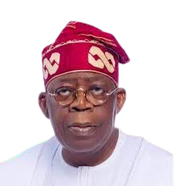
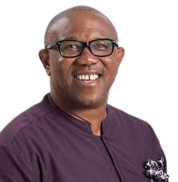
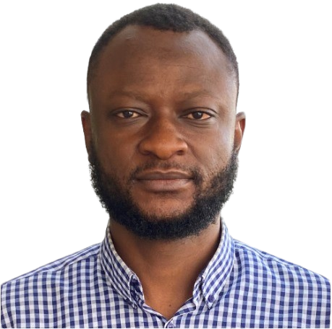


ONLINE WEBINAR ON
BUILDING
AND MANAGING EFFECTIVE BUSINESS
Host
BOLA
TINUBU
Speaker
PETER OBI
Speaker
UMAR ADEKOLA
Speaker
KWANKWASO RABIU
Starting and managing a business can be overwhelming, but you don’t have to do it alone. Our expert speakers will share their proven techniques and real-world experiences to help you navigate the complexities of entrepreneurship. Whether you’re launching a startup or looking to streamline your operations, this webinar is your gateway to business excellence.
→DATE←
→TIME←
SAT 1ST
June 2024
9 AM
Prompt
LET’S MEET @
https://meet.google.com/nix-kmsp-nqs
Enquires: +234 816 563 3455

Slide 3
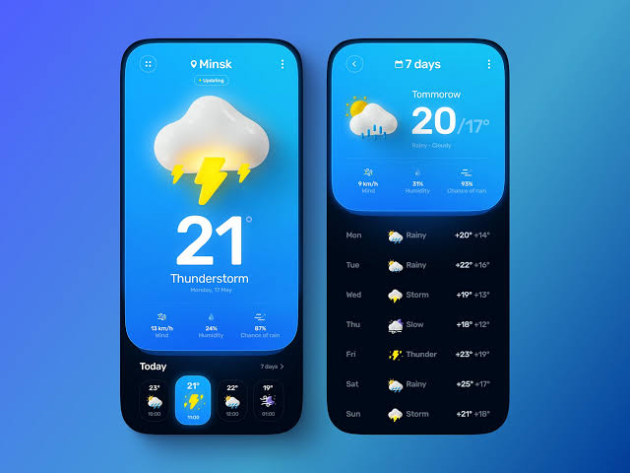













Minsk
7 days
Nigeria
Tomorrow
20/17˚
Sunny-Cloudy
21
9 km/h
Wind
3%
Humidity
87%
Chance of rain
˚
Mon
Rainy
+20˚ +14 ˚
Thunderstorm
Tue
Rainy
+22˚ +16 ˚
Monday, 17 May
Wed
Storm
+19 ˚ +13 ˚
13 km/h
Wind
24%
Humidity
87%
Chance of rain
Thu
Wind
+18 ˚ +12 ˚
Today
7 days >
Fri
Thunder
+23 ˚ +19 ˚
23˚
21˚
23˚
19˚
Sat
Rainy
+25 ˚ +17 ˚
10:00
11:03
12:00
10:03
Sun
Storm
+21 ˚ +18 ˚

Slide 4
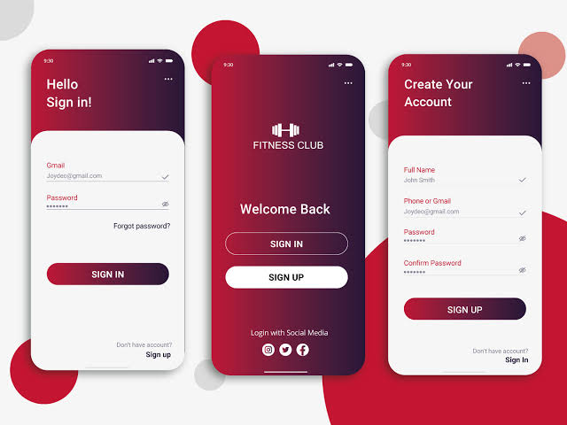









9:30
…
9:30
…
9:30
…
Hello
Create Your Account
Sign in!
FITNESS CLUB
Gmail
Full Name
Adekola.au@gmail.com
Umar Adekola
Password
Phone or Gmail
……..
Welcome Back
Adekola.au@gmail.com
Password
SIGN IN
……..
Confirm Password
SIGN IN
SIGN UP
……..
SIGN UP
Don’t have account?
Login with Social Media
Sign up
Don’t have account?
Sign In

Slide 5
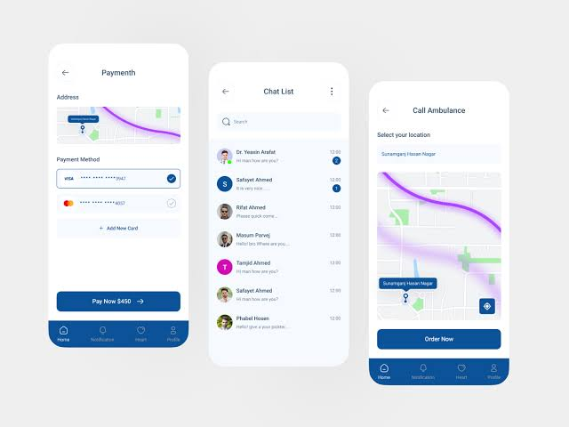


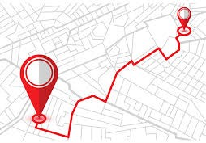

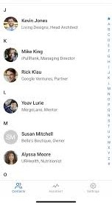

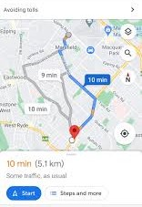






Payment
Chat List
Address
Call Ambulance
Search
Select your location
Payment Method
Mc Lawson Clinic
VISA
…. …. …. 4567
…. …. …. 4567
+ Add New Card
Pay Now $450
Home
Notification
Heart
Profile
Order Now
Home
Notification
Heart
Profile
Notification

